Slide 1
Attention is all you need
By Nasim Faridnia
Graduate Research Assistant
The University of Texas at San Antonio
September 2024

Slide 2
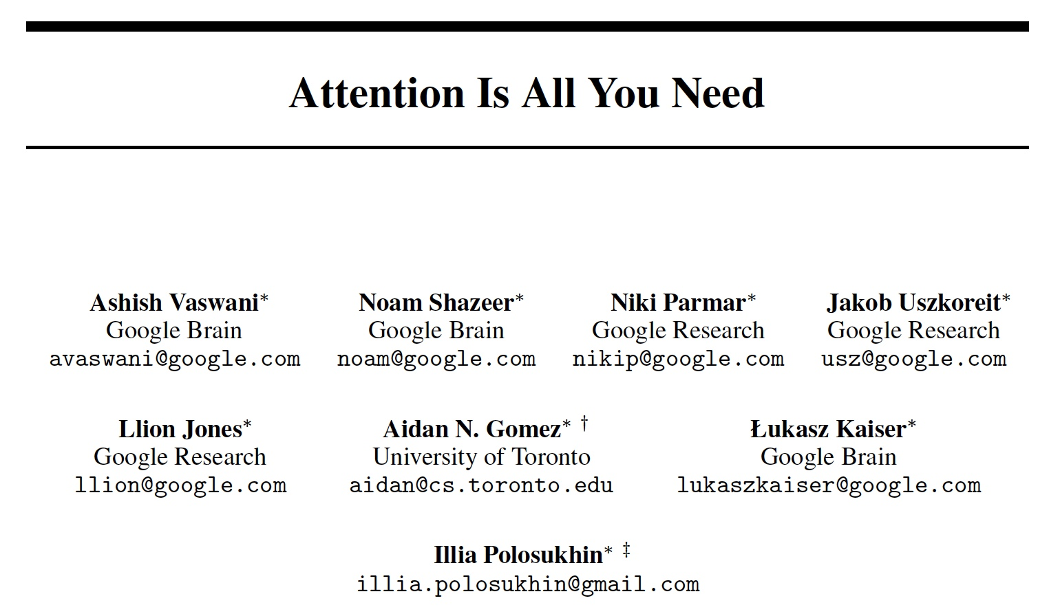

Slide 3
Introduction
Model Architecture
Results and Performance
Conclusion

Slide 4
Introduction

Slide 5
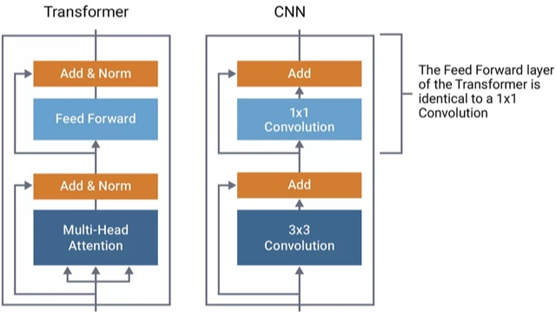
Limitations of Traditional Sequence models
Recurrent models (RNNs, LSTMs) and CNNs are widely used for sequence transduction tasks (e.g., translation, language modeling).
RNNs process inputs sequentially, limiting parallelism and increasing training time.
CNNs are more parallelizable, but their ability to capture long-range dependencies is limited.
Transformer replaces recurrence and convolutions with a novel self-attention mechanism.
semiengineering.com
Notes:
Limitations of Traditional Sequence models

Slide 6
Model Architecture

Slide 7
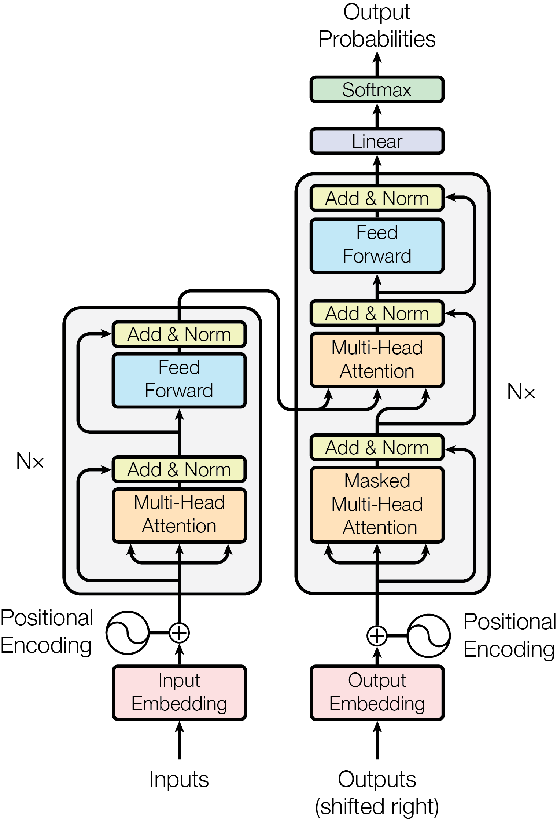
Transformer: A New Architecture
Encoder-Decoder Architecture: Input sequence → Encoder → Decoder → Output Sequence.
No recurrence, no convolutions — fully based on self-attention.
More parallelizable, faster training, and superior translation performance.
Figure 1 from paper
Notes:
Limitations of Traditional Sequence models

Slide 8
Encoder-Decoder Stack
The encoder consists of 6 identical layers with two sub-layers: multi-head self-attention and feed-forward.
The decoder also has 6 identical layers, with an additional encoder-decoder attention layer.
Residual connections and layer normalization improve stability.
Notes:
Limitations of Traditional Sequence models

Slide 9
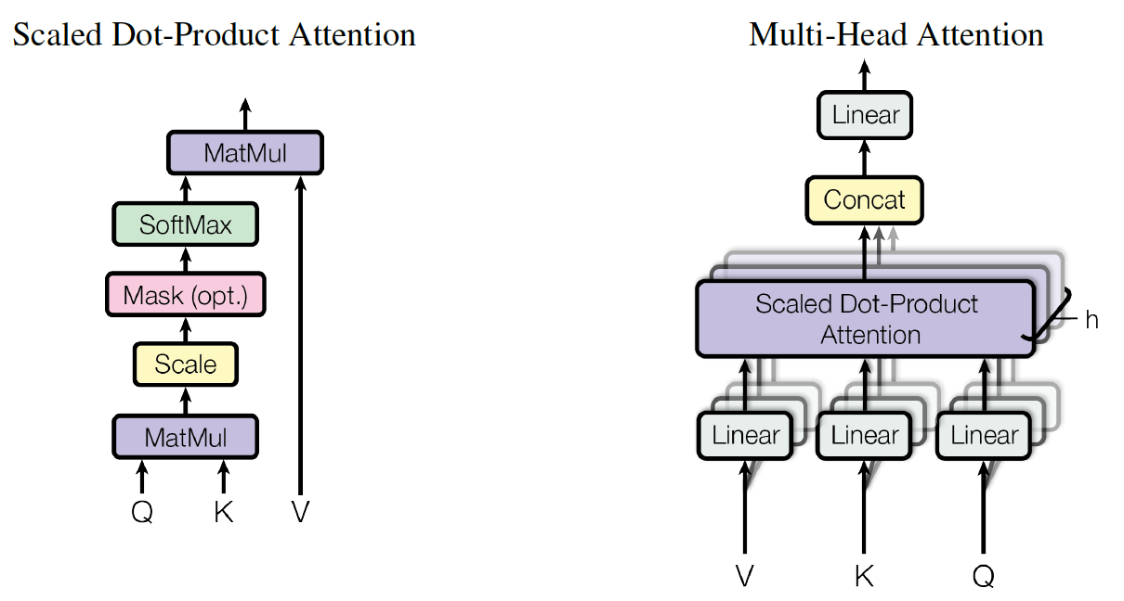
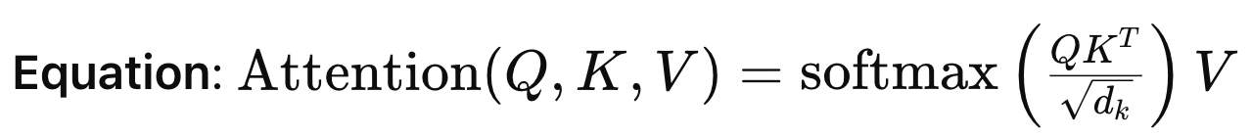
Self-Attention: Key Concept
Self-attention computes the importance of each word in a sequence relative to others, allowing global dependencies to be learned.
Query, Key, Value (Q, K, V): For each input word, compute attention scores between the word (Query) and all others (Keys), then weight the values accordingly.
The model can focus on distant words effectively, unlike RNNs.
Figure 2 from paper

Slide 10
Multi-Head Attention
Instead of applying a single attention function, queries, keys, and values are projected into different subspaces (heads).
The attention is applied in parallel across multiple heads to capture different aspects of the input.
Attention heads are then concatenated and projected to the original dimension.
Figure 2 from paper
Notes:
Each head pays attention to different relations

Slide 11
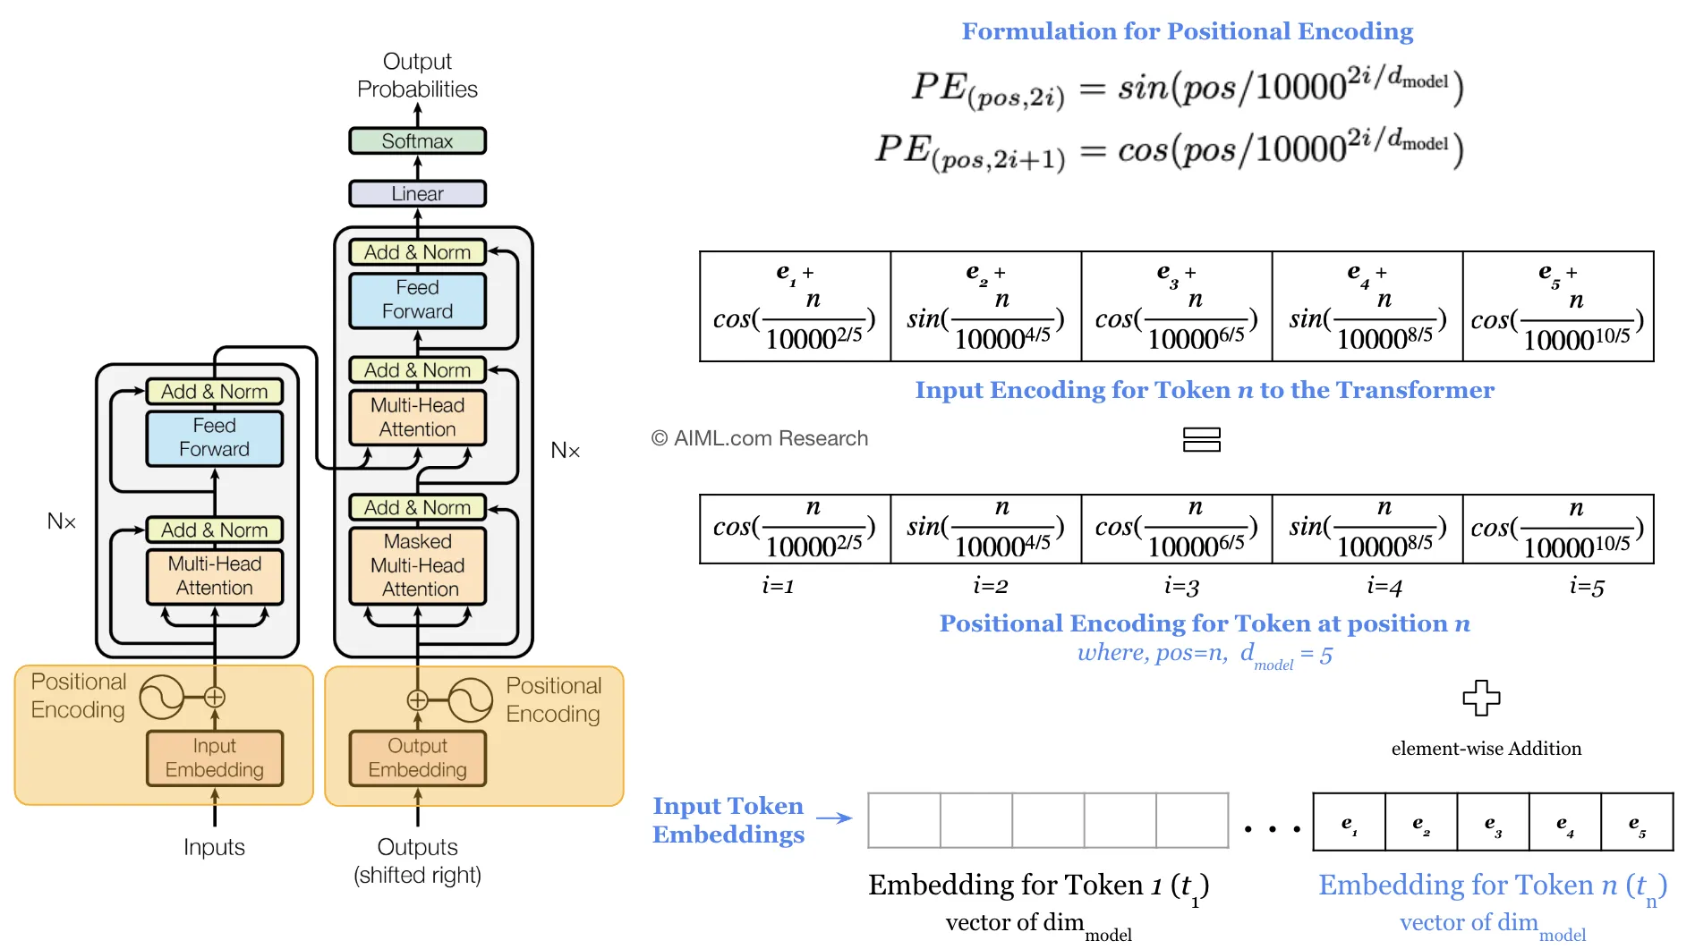
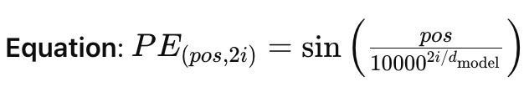
Positional Encoding
Since Transformer lacks recurrence, positional information is added via sinusoidal positional encodings.
Each position is encoded as a vector using sine and cosine functions of different frequencies.
This helps the model understand the order of words.
From AIML.com
Notes:
Capture long range and short range dependencies

Slide 12

Feed-Forward Layers
Each layer in the encoder and decoder applies a pointwise feed-forward network to each position separately.
This consists of two linear transformations with a ReLU activation in between.
Helps in non-linear transformations and captures complex dependencies.
Notes:
Limitations of Traditional Sequence models

Slide 13
How the Transformer Works
Self-attention is applied across the input sequence to relate all words in parallel in encoder.
The decoder attends to both its own previous outputs and the encoder's output.
Auto-Regressive: The model generates each output token one at a time by attending only to previously generated tokens.
Notes:
Understand dependency between words
each token is produced one at a time based on the tokens that have already been generated

Slide 14
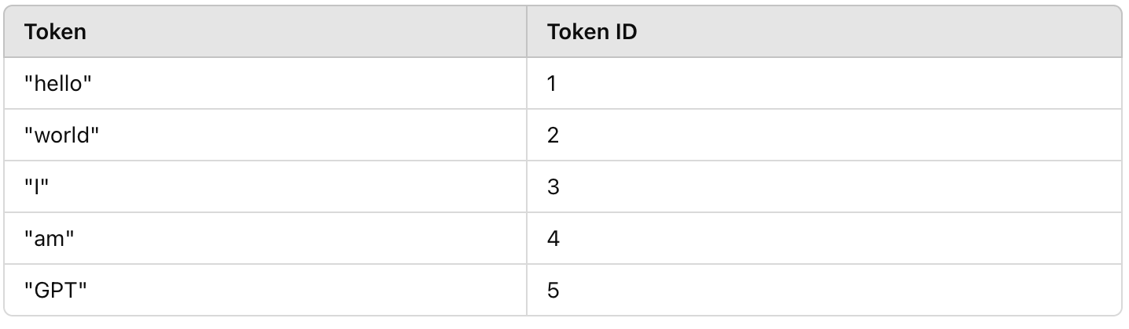
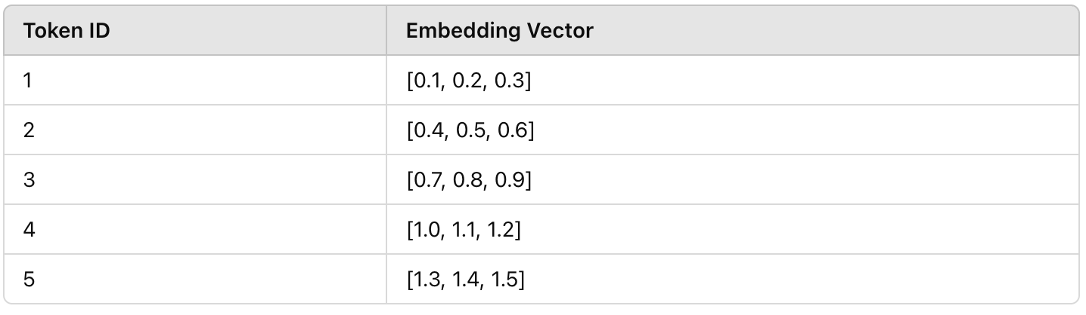
Dictionaries: How Transformers Understand Words
A dictionary in transformers maps tokens to unique IDs and then uses an embedding layer to convert those IDs into vectors.
It is achieved through tokenization and embedding lookup.
It enables the transformer to work with text data by converting words into numerical form, facilitating the learning of word meanings and relationships.
"hello world" -> “hello”, “world” -> Token IDs: [1, 2] -> Embedding Vectors: [[0.1, 0.2, 0.3], [0.4, 0.5, 0.6]]
Notes:
Limitations of Traditional Sequence models

Slide 15
Performance and results

Slide 16
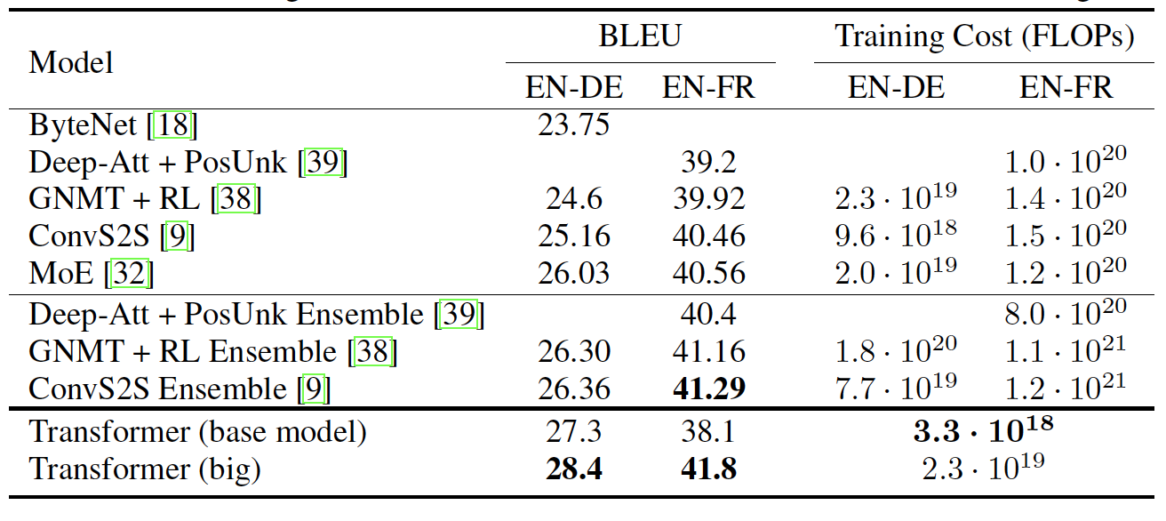
Superior Performance in Machine Translation
BLEU Scores: The Transformer achieved 28.4 BLEU on English-to-German and 41.8 on English-to-French tasks.
Faster training: The base model trained in 12 hours on 8 GPUs, and the big model trained in 3.5 days.
More efficient than RNN/CNN models.
Table 2 from paper
Notes:
Limitations of Traditional Sequence models

Slide 17
Advantages of Self-Attention: Why self-attention over RNN and CNN?
Efficiency: Self-attention enables parallelization across positions, unlike RNNs which are sequential.
Long-Range Dependencies: Self-attention handles long-range dependencies better than CNNs.
Interpretability: Self-attention weights provide insights into what the model is focusing on at each step.
Notes:
Limitations of Traditional Sequence models

Slide 18
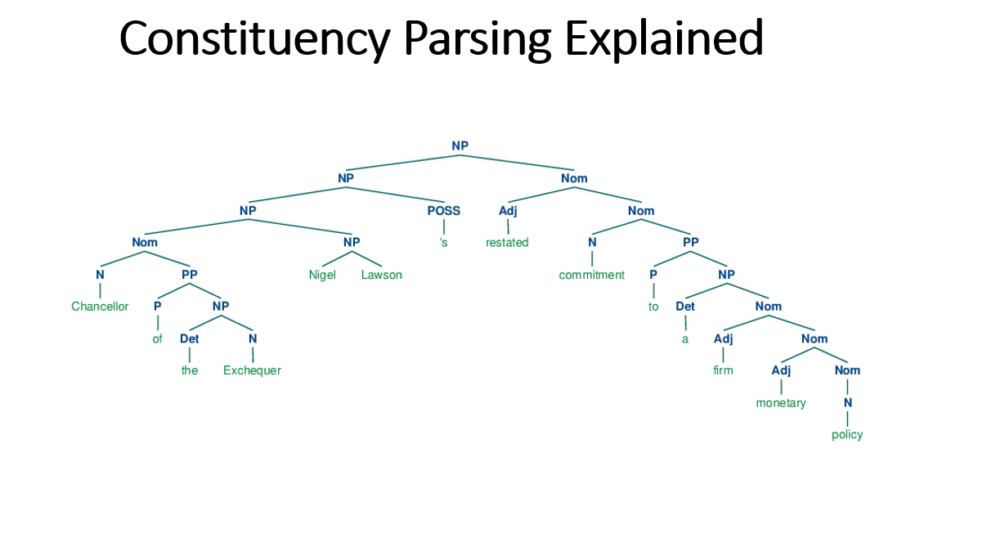
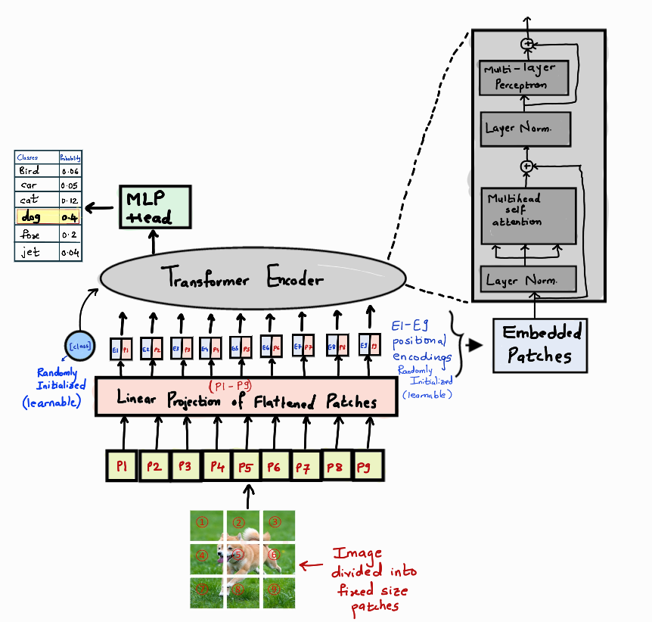
Beyond Translation: Generalization to Other Tasks
The Transformer model has been extended to tasks like:
Constituency Parsing: Achieving competitive results on the Penn Treebank dataset.
Vision Transformers (ViT): Applying the same architecture to image classification: Image Classification, Object Detection, Video Deepfake Detection, Image segmentation, Anomaly detection, Image Synthesis, Cluster analysis, Autonomous Driving.
From medium
Notes:
Limitations of Traditional Sequence models

Slide 19
Conclusion

Slide 20
The Transformer revolutionized sequence modeling by replacing recurrence and convolutions with self-attention.
Its efficiency, parallelization, and superior performance in machine translation and beyond make it a foundational model in deep learning.
The model continues to evolve and find new applications in NLP, vision, and multimodal tasks.
Notes:
Limitations of Traditional Sequence models

Slide 21
Thanks for listening
Any questions?

